Slide 1
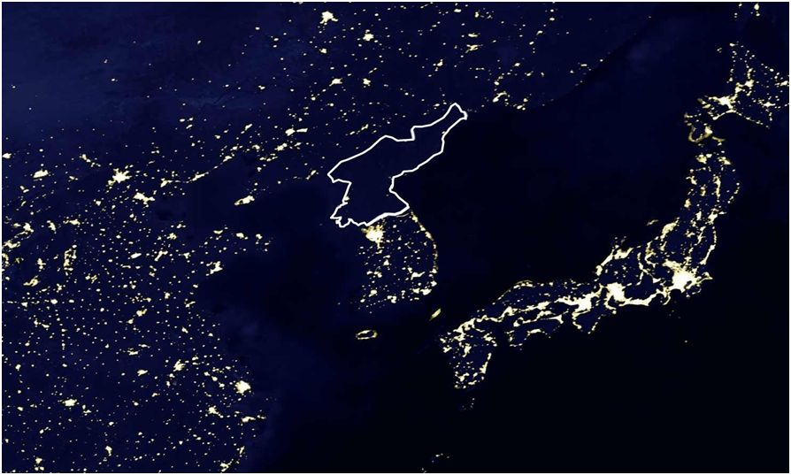
Chapter 11: Economic Growth and the Wealth of Nations
Wayne Geerling
University of Texas

Slide 2
Big Questions
Why does economic growth matter?
How do resources and technology contribute to economic growth?
What institutions foster economic growth?
How are some economists teaching new ideas?

Slide 3
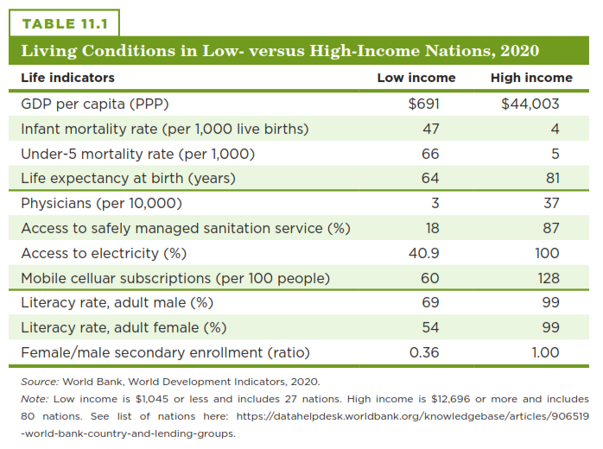
Human Welfare in Nations

Slide 4
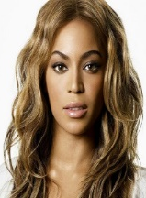
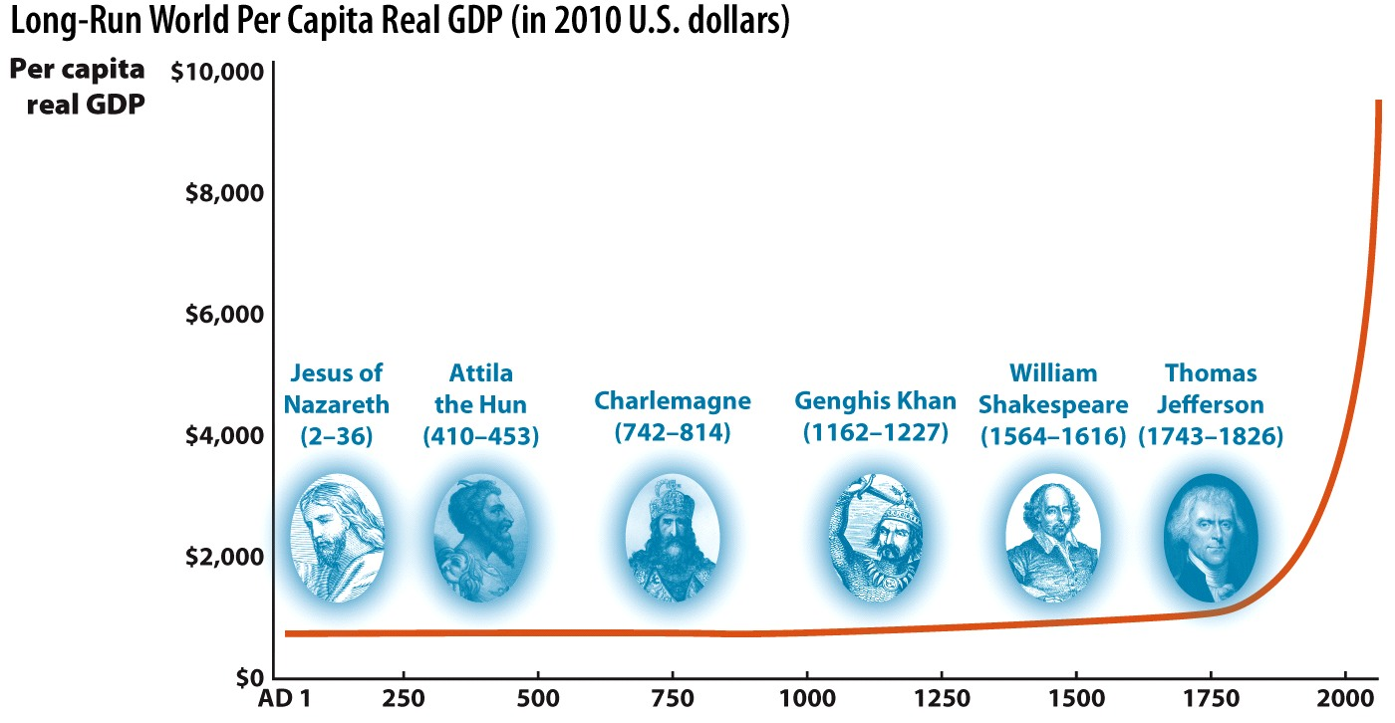
Long Run World Per Capita GDP (2010 U.S. Dollars)
Beyonce

Slide 5
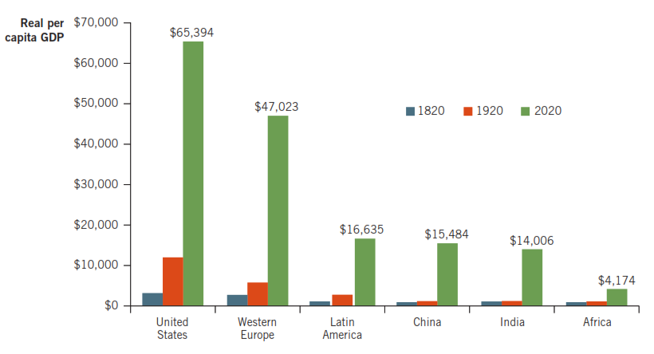
Some Got Rich…Others Stayed Poor

Slide 6
Mathematics of Growth
World economic growth might seem very slow, but small amounts of growth over a long period of time can make a huge difference.
Break out of poverty began in the nineteenth century.
Years | Growth Rate
1–1800 | 0.02%
1800–1900 | 0.64
1900–1950 | 1.04
1950–2000 | 2.12

Slide 7

Mathematics of Growth
Economic growth is measured as the growth of real GDP per capita.
Real GDP per capita allows us to compare incomes throughout time by controlling for inflation and population changes.
$$=\%∆Nominal GDP−\%∆Prices−\%∆Population$$
$$=\%∆per capita Real GDP$$

Slide 8
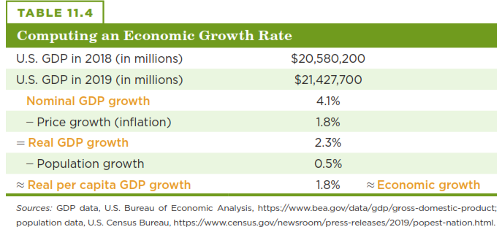
Computing Economic Growth

Slide 9
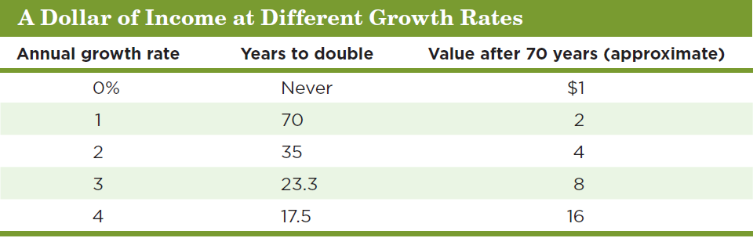
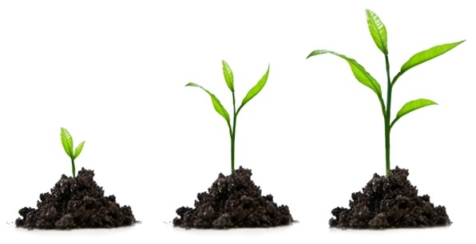
World Economic Growth for Different Historical Eras
Small differences in growth rates are important!
The Rule of 70: annual growth rate is X%, size doubles in 70/x years

Slide 10
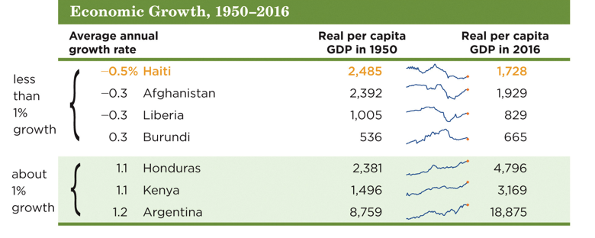
Economic Growth, 1950-2016

Slide 11
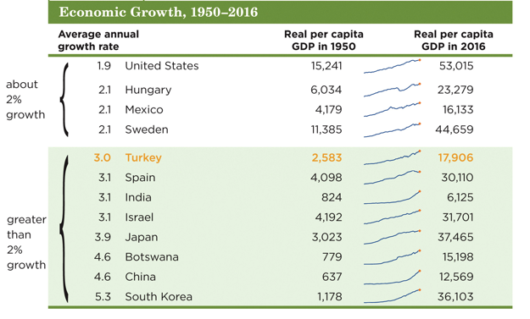
Economic Growth, 1950-2016

Slide 12
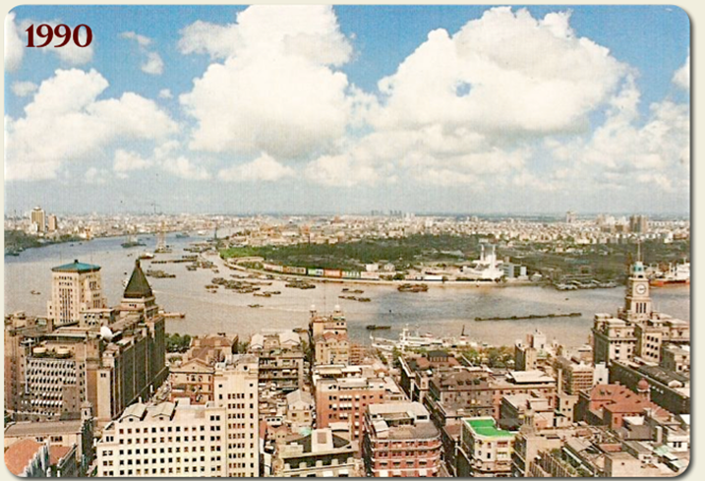
Which city is this?

Slide 13
The Causes of Economic Growth
Economic growth affects income, life expectancy, and standards of living.
The sources of economic growth are:
Resources
Technology
Institutions

Slide 14
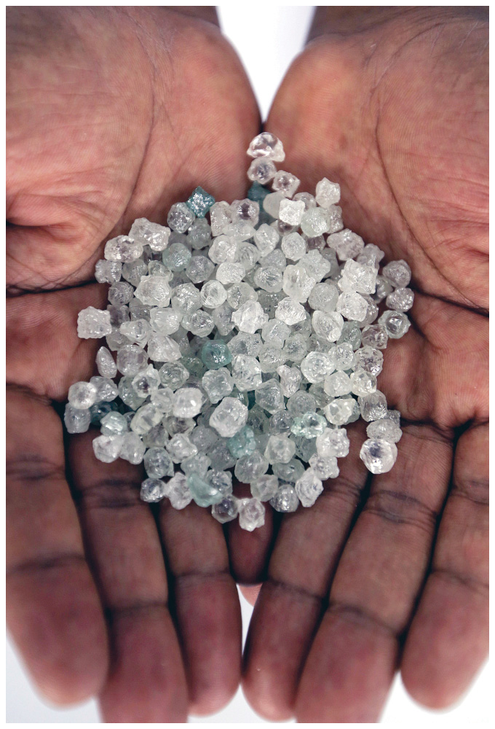
Resources
Resources are the inputs used to produce goods and services.
Also referred to as factors of production
Resources comprise:
Natural resources
Human capital
Physical capital

Slide 15
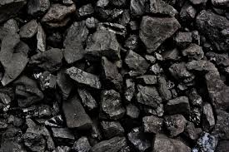
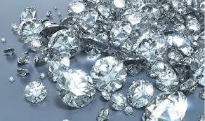
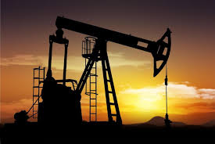
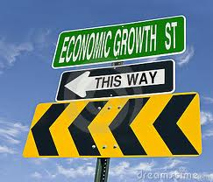
Natural Resources
United States
South Africa
Saudi Arabia

Slide 16
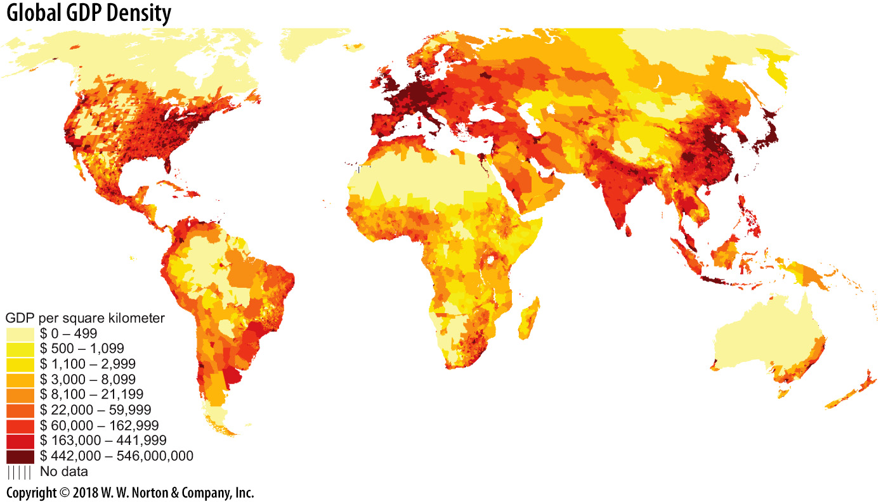
Global GDP Density
Geography affects weather, disease & trade possibilities

Slide 17
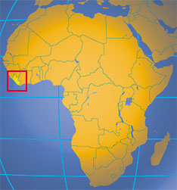
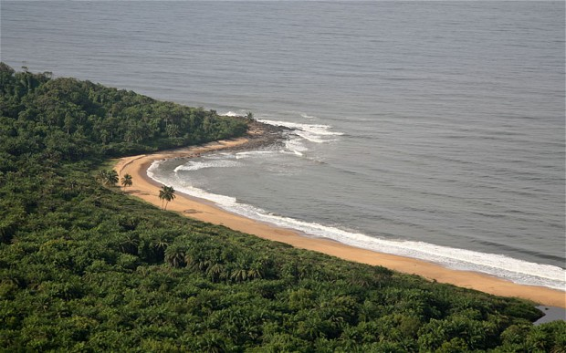
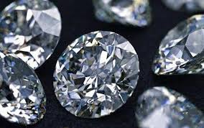
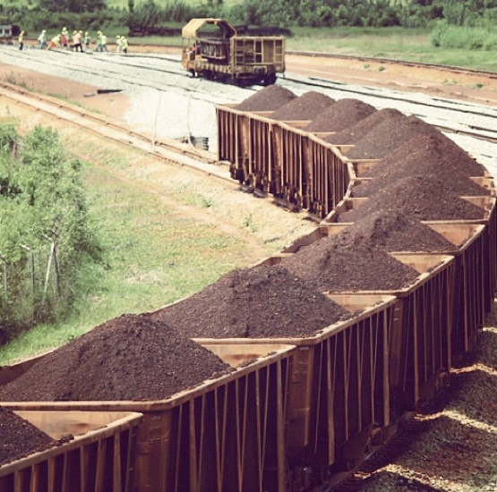
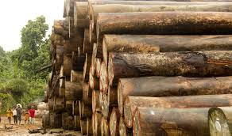
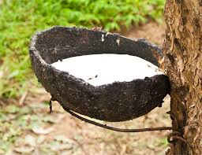
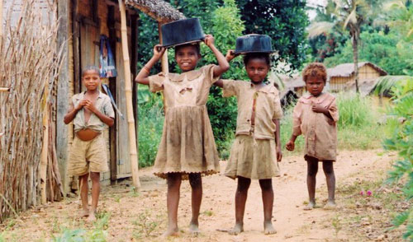
But natural resources are not enough!
GDP per capita (IMF, 2023): $ . Liberia ranked #180

Slide 18
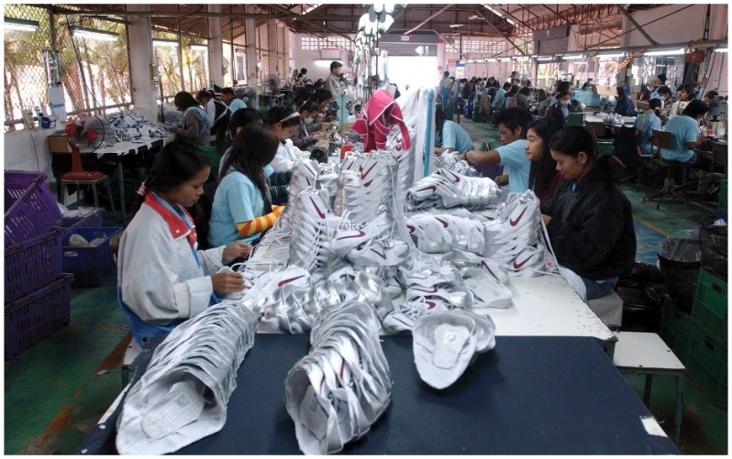
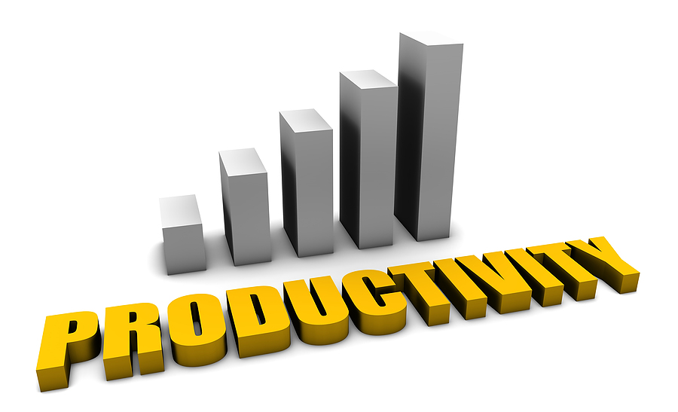
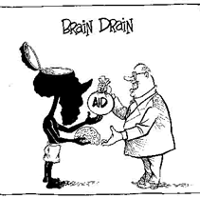
Human Capital
Importance of human capital: knowledge & skills
Skilled professionals often come from poor countries

Slide 19
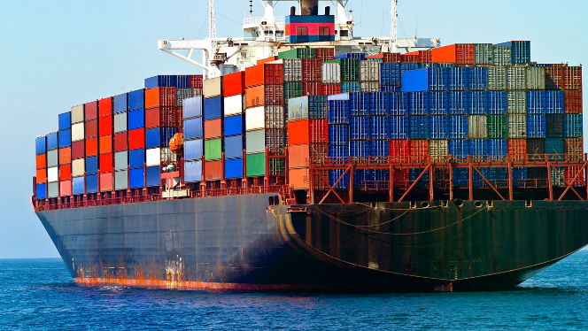
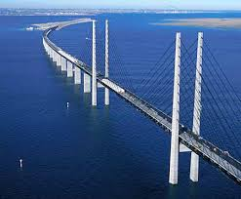
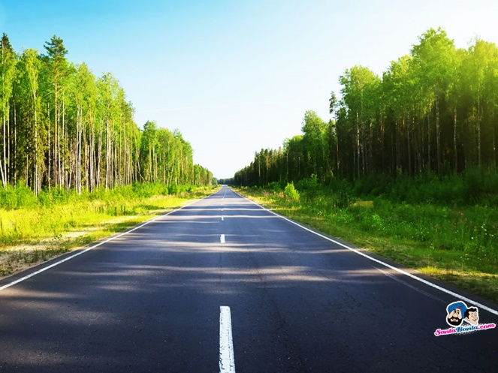
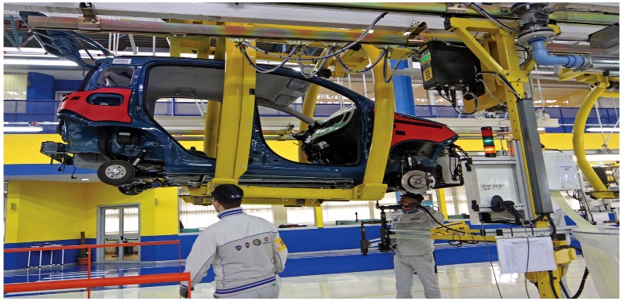
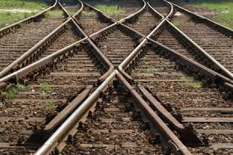
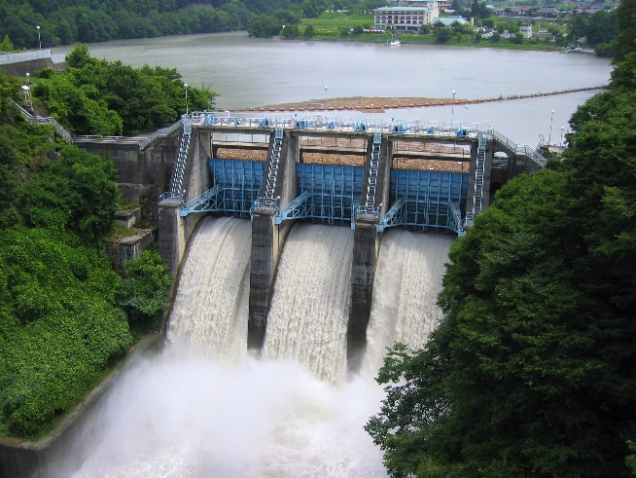
Physical Capital
Capital alone is not sufficient to produce economic growth

Slide 20

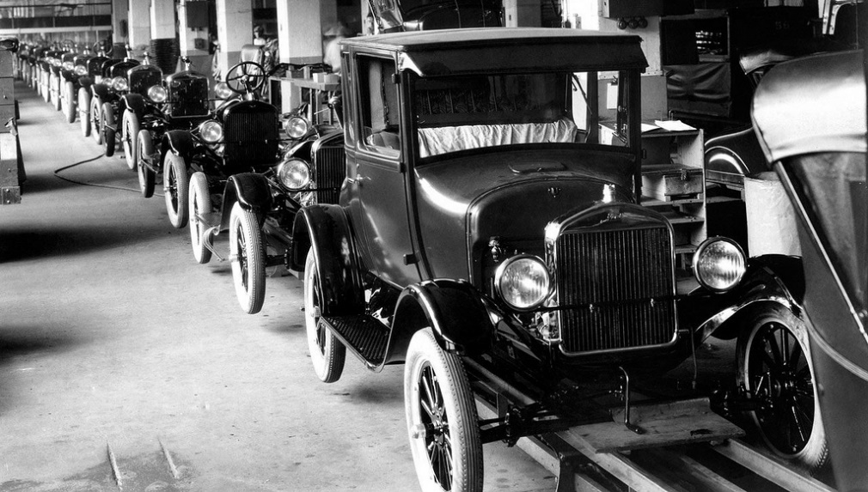
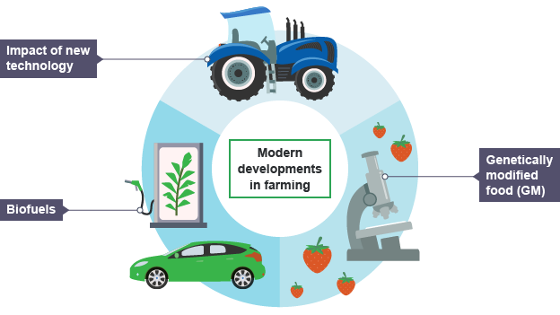
Technology
The ability to produce more with less
Why do some regions innovate (and grow) more than others?

Slide 21
What Economic Growth Requires: Institutions Matter!
are significant practices, relationships, or organizations in a society.
They are the official & unofficial conditions that shape the environment in which decisions are made.
Include laws, regulations & government. Also include work habits, expectations & political behavior.

Slide 22
5 Important Institutions
1. Private property rights
2. Political stability and rule of law
3. Stable money and prices
4. Competitive and open markets
5. Efficient taxes

Slide 23
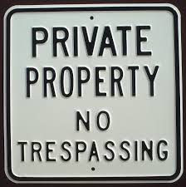
1. Private Property Rights
The rights of individuals to own property, to use it in production, and to own the resulting output.
Perhaps the most important institution to growth.
Creates the incentive for people to be & expand production.

Slide 24
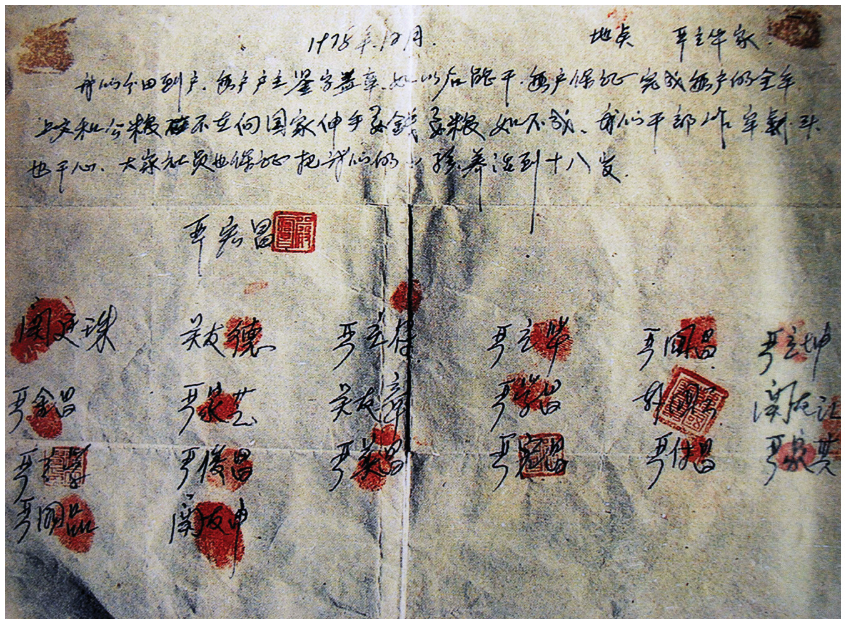
Xiaogang Agreement
Farmers split commune into family-owned plots & agreed to keep surplus agricultural output beyond government quota.
Result:
Agricultural boom in Xiaogang.
More output than previous five years combined.
Chinese leaders instituted agricultural reforms in 1980s & manufacturing reforms in 1990s.

Slide 25

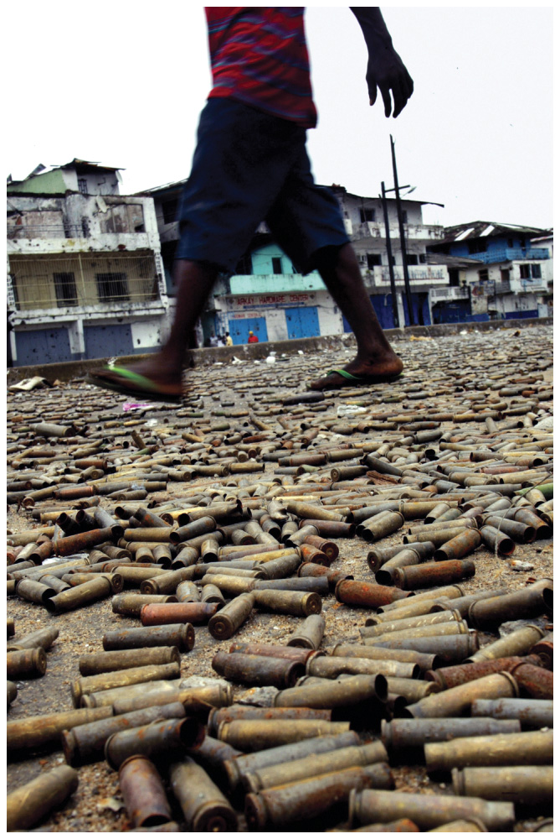
2. Political Stability and Rule of Law
Consistent and trustworthy enforcement of a nation’s laws is crucial for economic growth.
In an environment of political instability, there is no to in either human or physical capital because there is no future payoff.

Slide 26
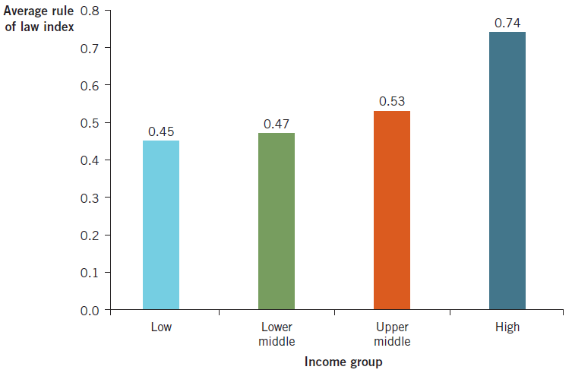
Political Stability and Rule of Law
The World Justice Project shows how high-income nations are also nations that adhere most closely to the rule of law.

Slide 27
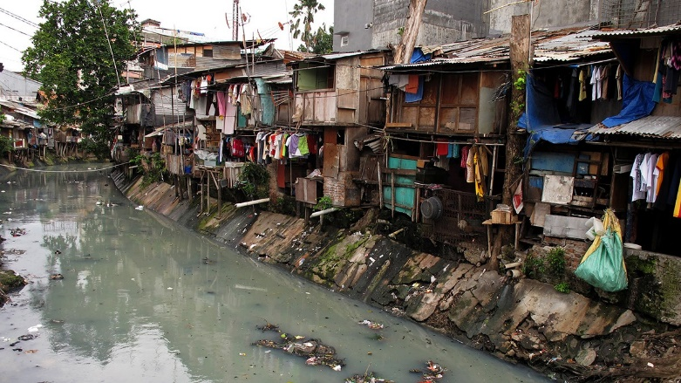
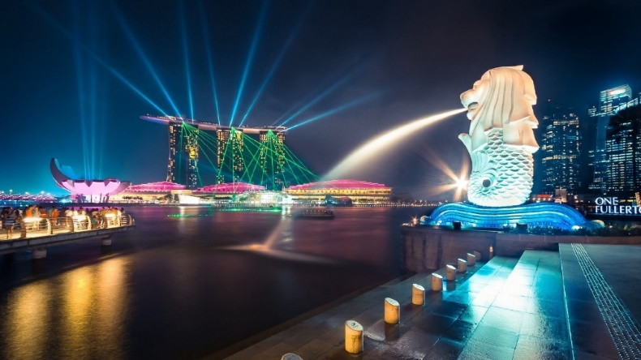
A Simple Comparison
Liberia
Singapore
Rich in natural resources, e.g. iron ore, gold, diamonds, timber & rubber.
Per capita income $ (# ).
Has very few natural resources.
Smaller than NYC.
Per capita income $ (#).

Slide 28
Liberia
Singapore
Racked by political instability, corruption & civil unrest.
Given $ billion in international aid, 1980-2003.
No incentive for education & investment.
Poor environment for economic growth.
Highly educated & industrious labour force.
Attractive market for foreign investment.
Stable financial system, protects property rights & encourages free trade.
Strategic position: deep-water port.

Slide 29
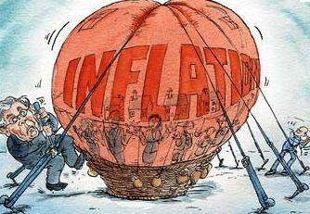
3. Stable Money and Prices
Uncertainty about future prices makes people reluctant to invest which decreases future growth possibilities.
A stable rate helps incentivize growth.
The Fed Reserve plays a key role here.

Slide 30


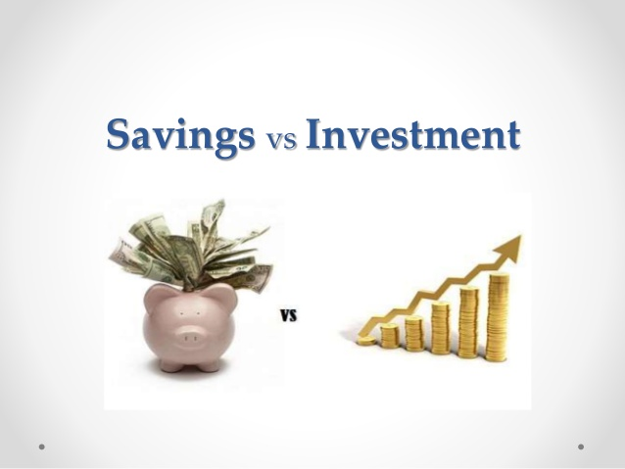
4. Competitive and Open Markets
There are 3 market institutions that are essential for economic growth:
1. Competitive markets
2. International trade
3. Flow of funds across borders

Slide 31

5. Efficient Taxes
: sufficient to fund the activities of government while not impeding production and consumption decisions.
High enough to support an effective government but low enough as to not reduce incentives for production.

Slide 32
Economists Are Testing New Ideas
2019 Nobel Prize in Economics went to 3 economists who use randomized controlled trials (RCTs) to study the effects of public policies.
Michael Kremer showed that school attendance could be improved by treating children for hookworms.
Abhijit Banerjee & Esther Duflo showed that microcredit business loans reduced poverty less than what was believed.
An RCT groups people to compare & test policies & initiatives.

